Slide 1



Automatically Detecting Online Deceptive Patterns
Asmit Nayak, Yash Wani*, Shirley Zhang*, Rishabh Khandelwal, Kassem Fawaz
University of Wisconsin – Madison
anayak6@wisc.edu
wiscprivacy.com
*Equal Contribution
ACM CCS 2025

Slide 2
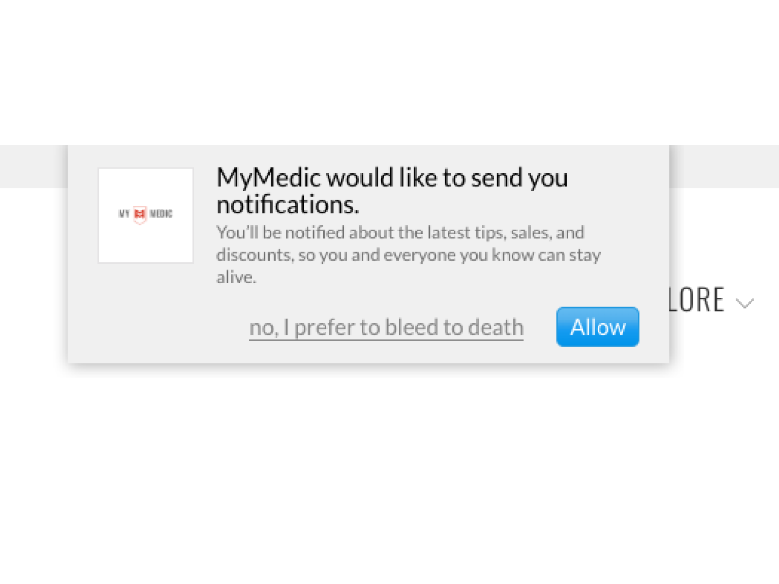

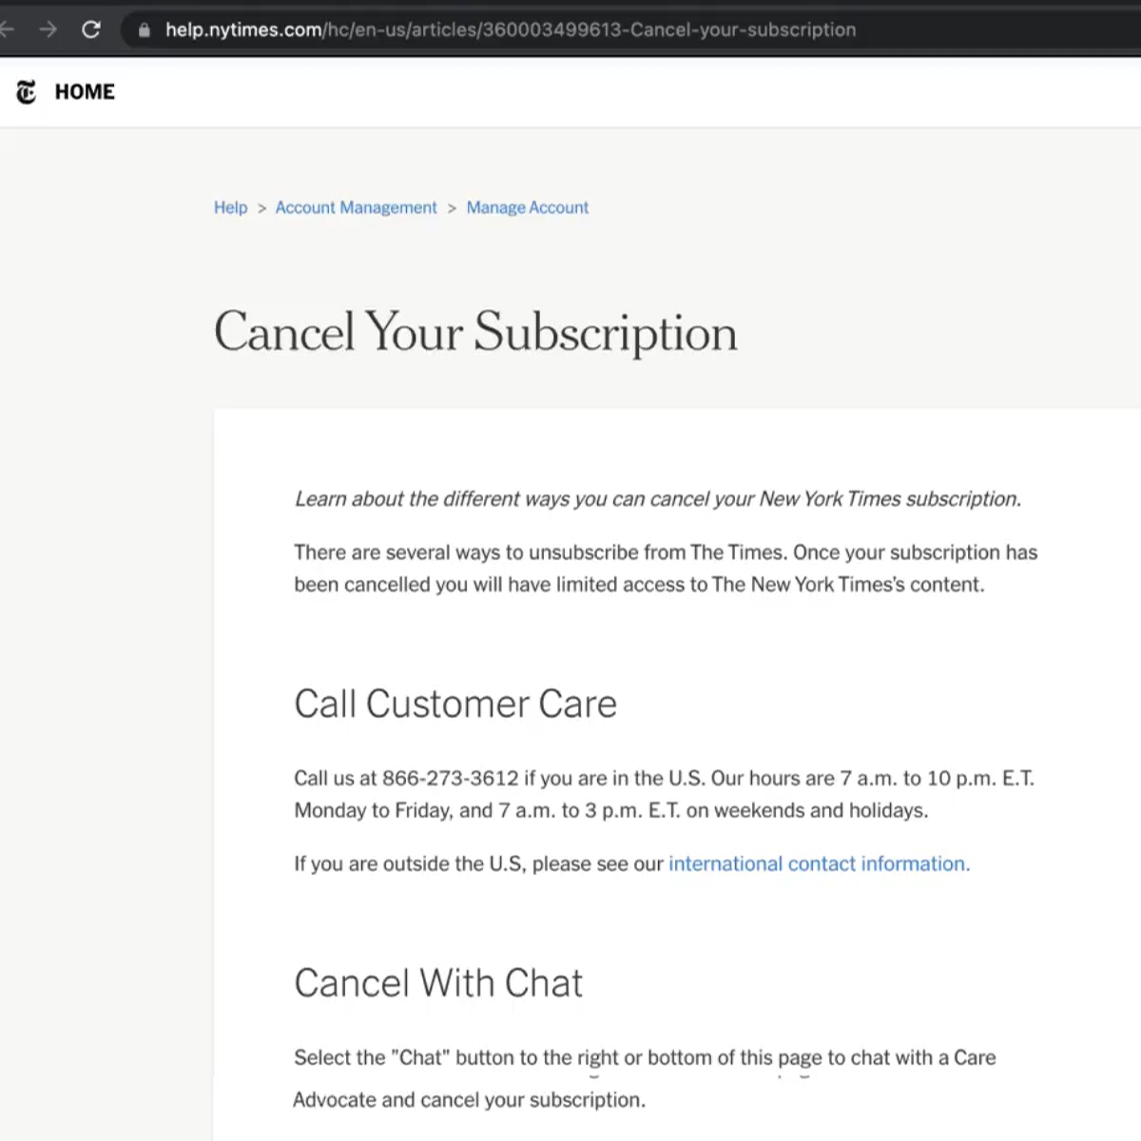
What Are Deceptive Patterns (DP)?
These are tricks that websites use to make users perform website-friendly choices rather than privacy or user-friendly ones.
Confirmshaming*
Sneaking⁺
Hard to Cancel⁺
Credits:
*: https://www.deceptive.design/types
+: https://pudding.cool/2023/05/dark-patterns/
Notes:
Add the background into this one – two slides

Slide 3



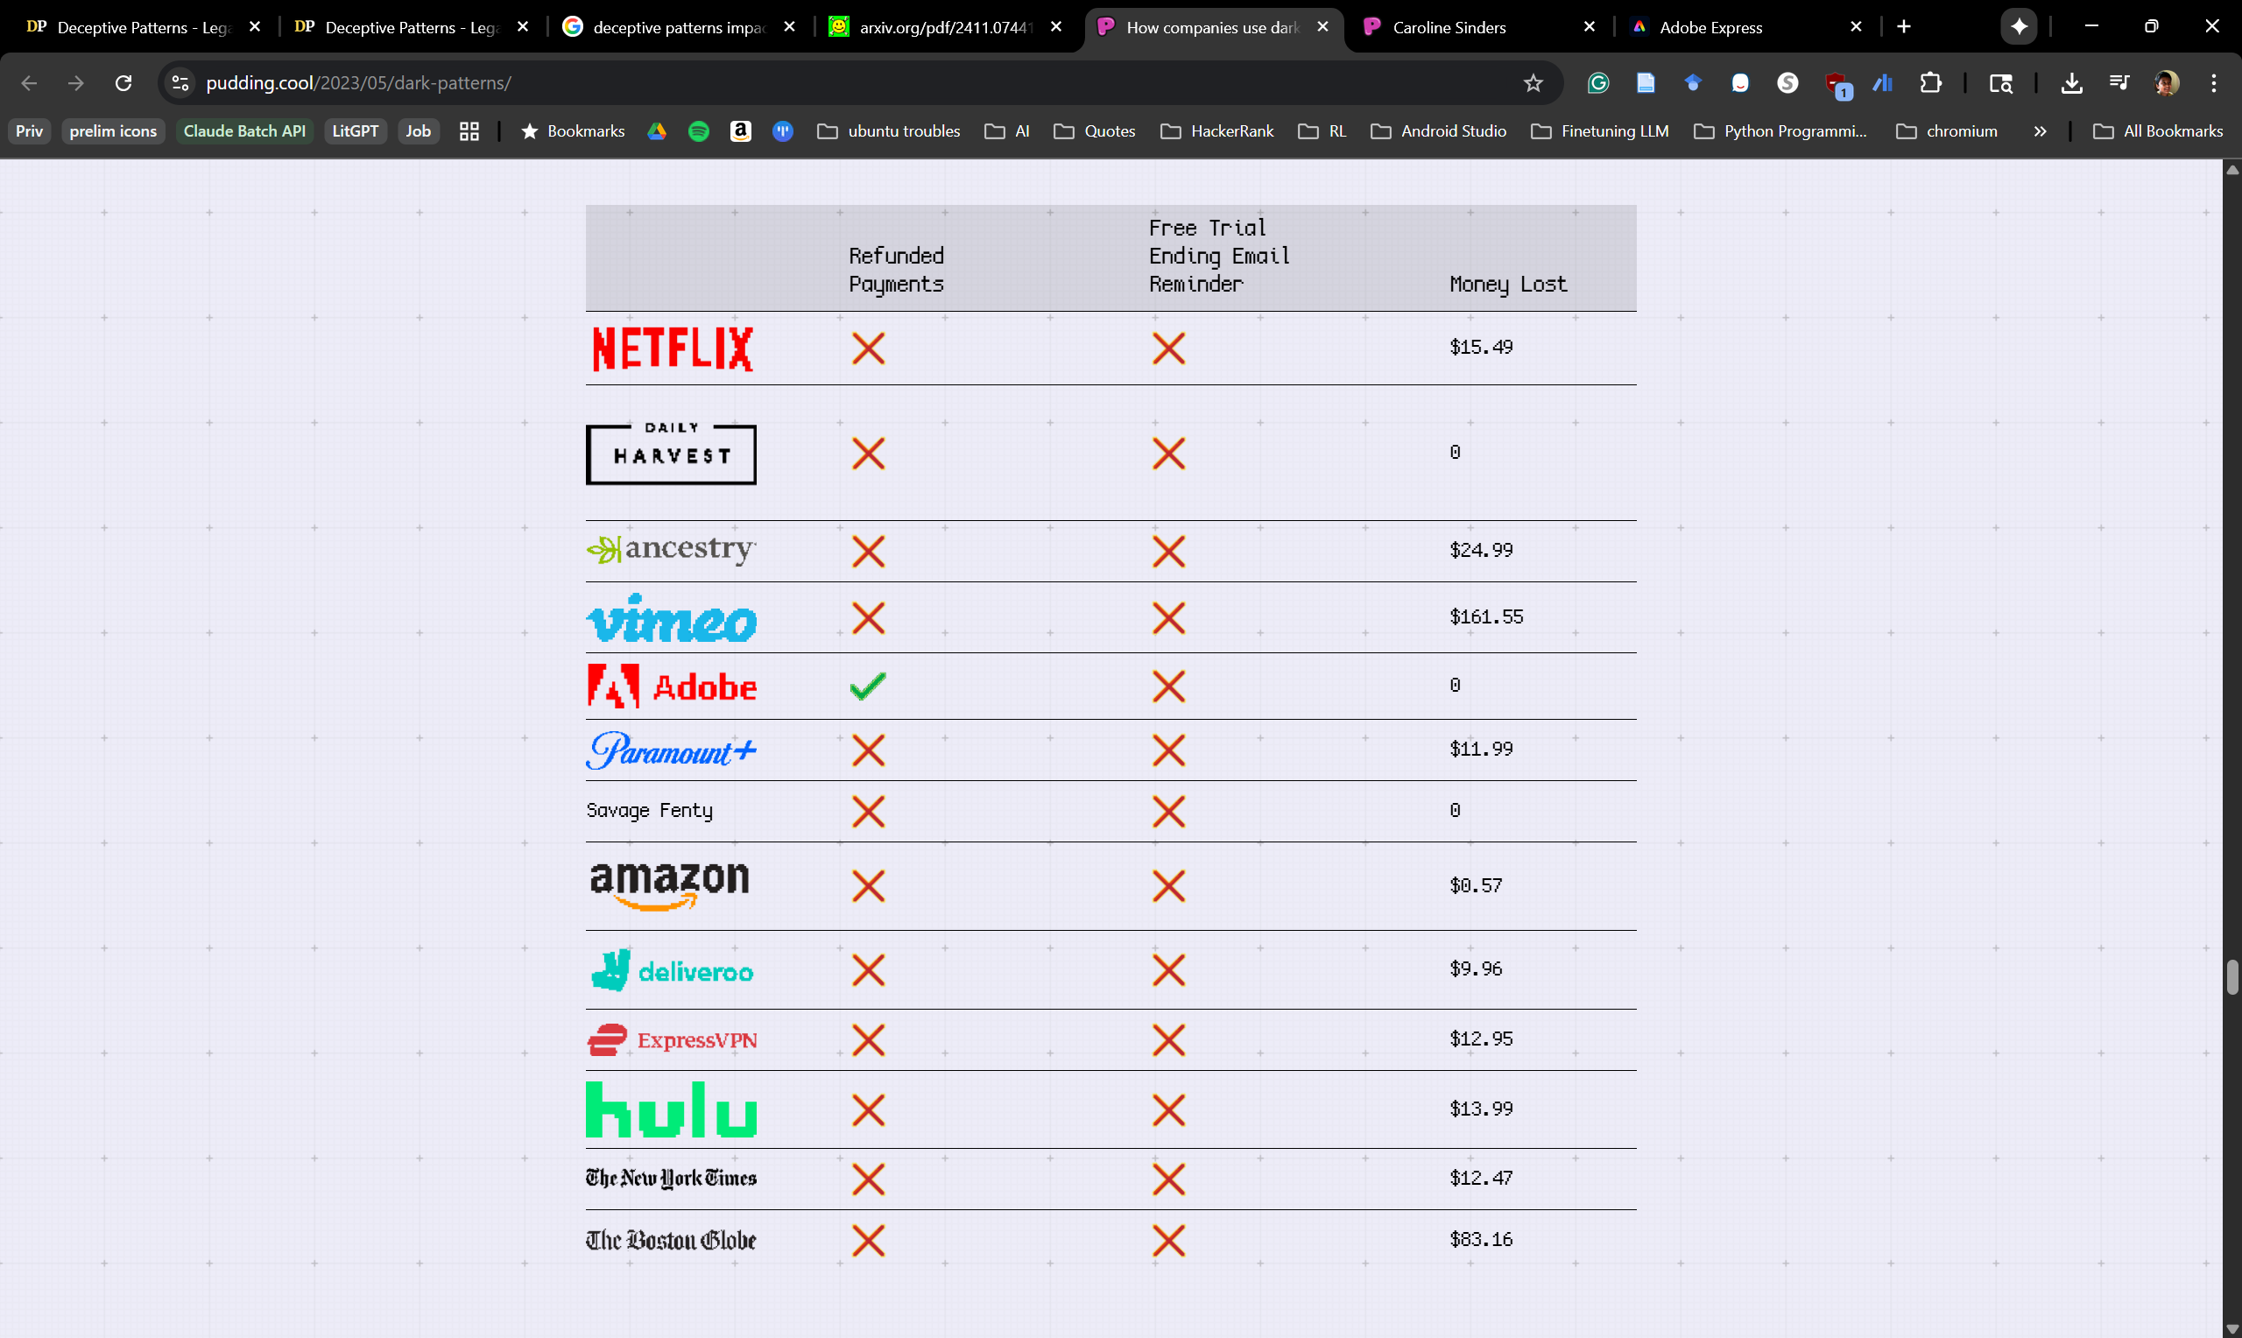
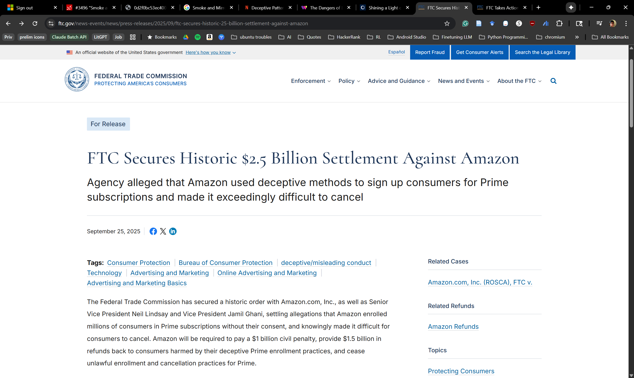

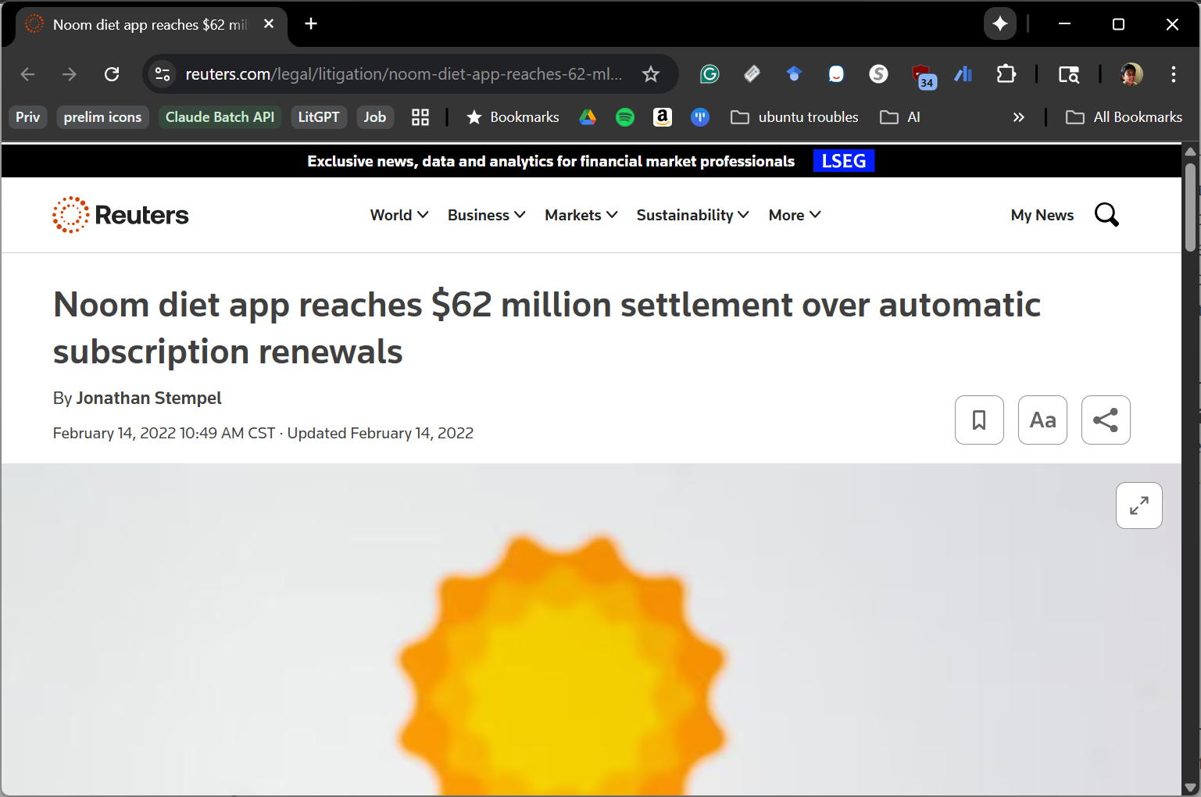
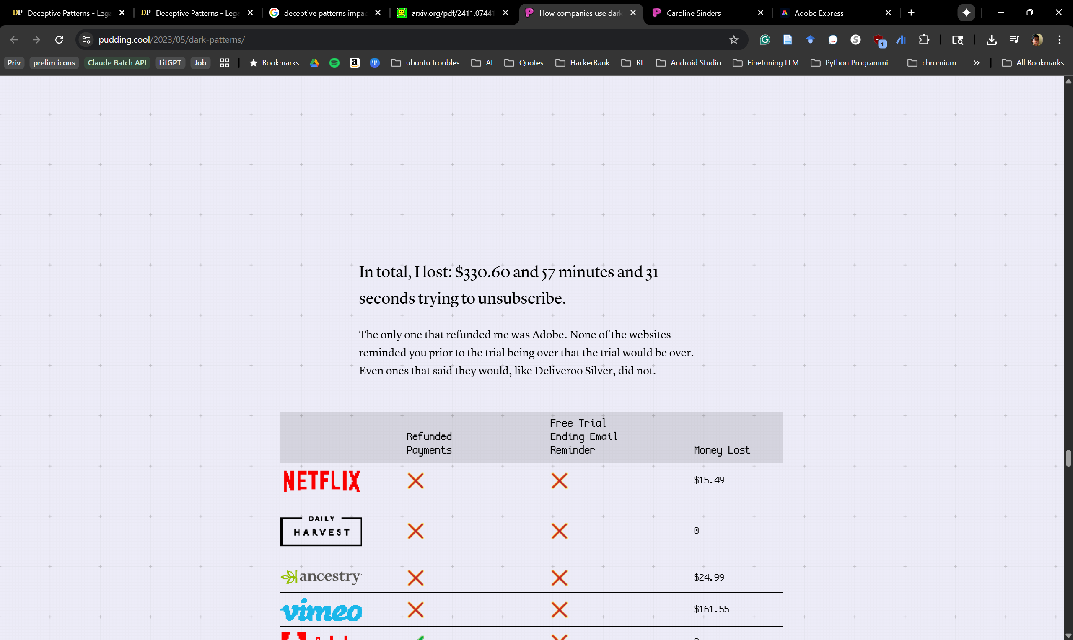

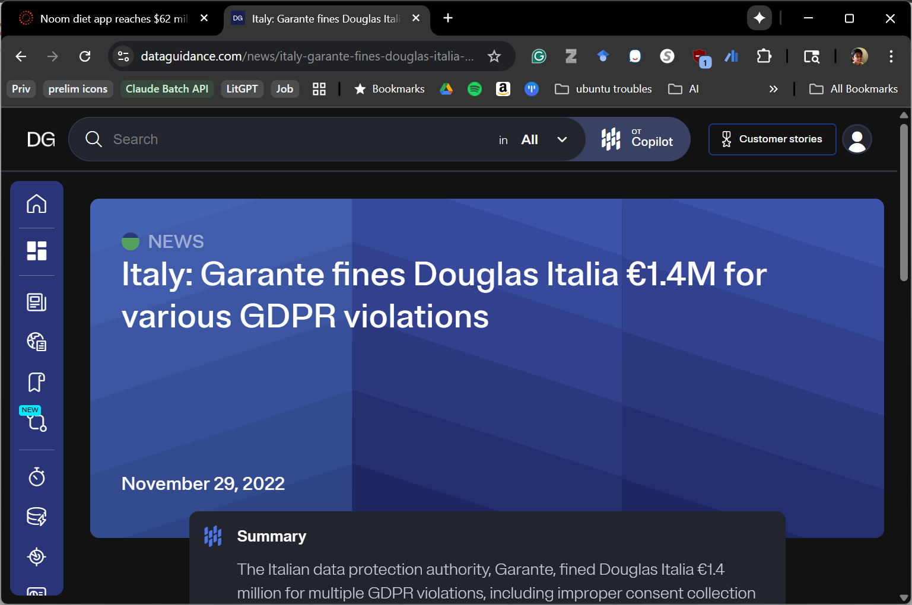
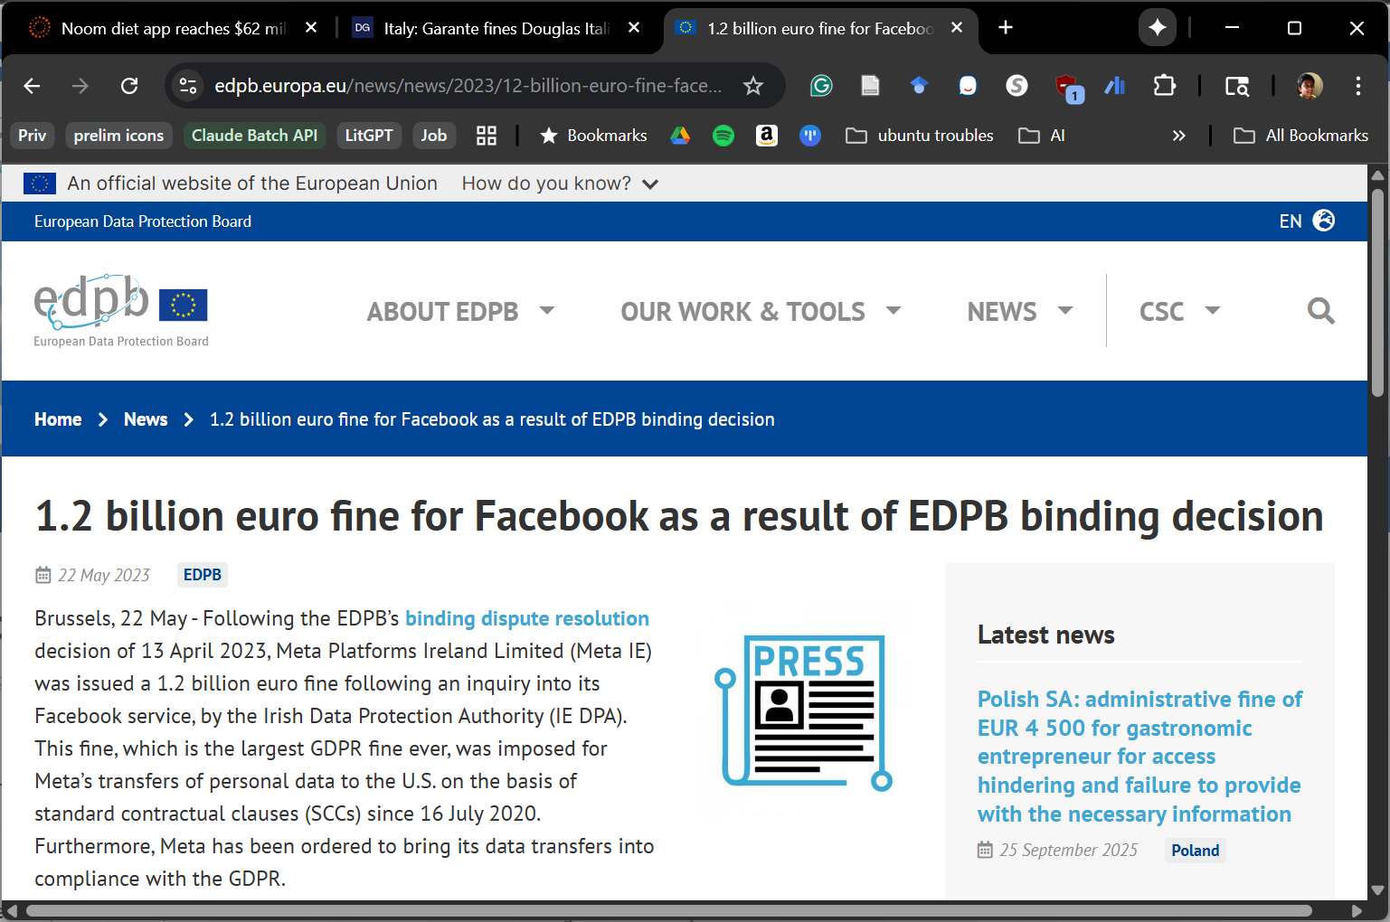


Impact of Deceptive Patterns
Everyday Users
Developers/Companies
Regulatory Agencies
… [Dark Patterns are present in] 11% of popular e-commerce websites … [and in] 95% of free Android apps in the U.S. Google Play Store.
https://pudding.cool/2023/05/dark-patterns
Notes:
And sometimes they make it really hard to unsubscribe...
Such dp impact various stakeholders f the web...
an experiment found that such practices are widespread...
Infact in this experiment the person lost over 300 dollars and took them almost an hr to cancel ...
Due to these dp, website owners or developers are also penalized, like here Amazon was fined 2.5 B dollars, and not just big tech such fines can also happen to smaller companies.
Now in order to regulate and enforce compliance, regulators need to manually examine the websites, and a recent study found that over 11% of e commerce websites have dp and almost all android apps do. So enforcing compliance on all of them is both infesible and extremely tiring.

Slide 4




Need for Automated Detection of DP
Alert and draw attention of users to the potential DPs on the site and their implications
Inform Developers about various DPs on their site and their potential consequences.
Automated DP Detection System
A scalable solution that can be used to perform automated compliance checks on websites
Notes:
So given such broad impacts, there is a need for an automatic or automated solution can be utilized by various stakeholders

Slide 5
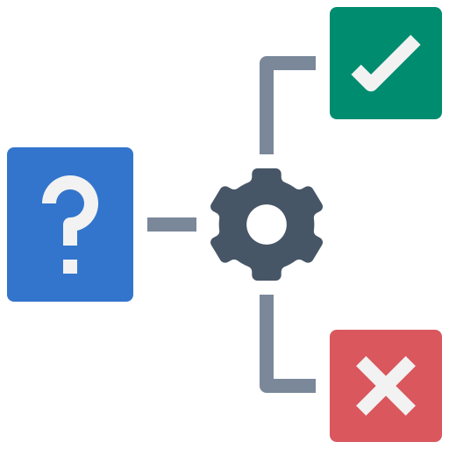
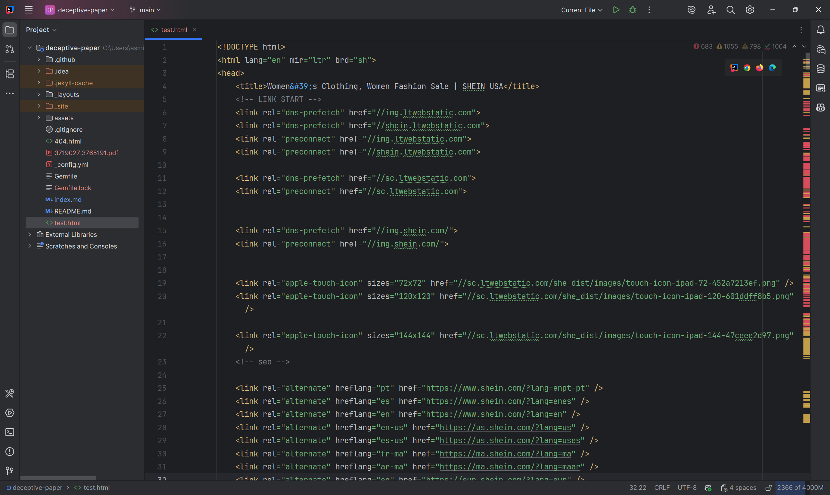

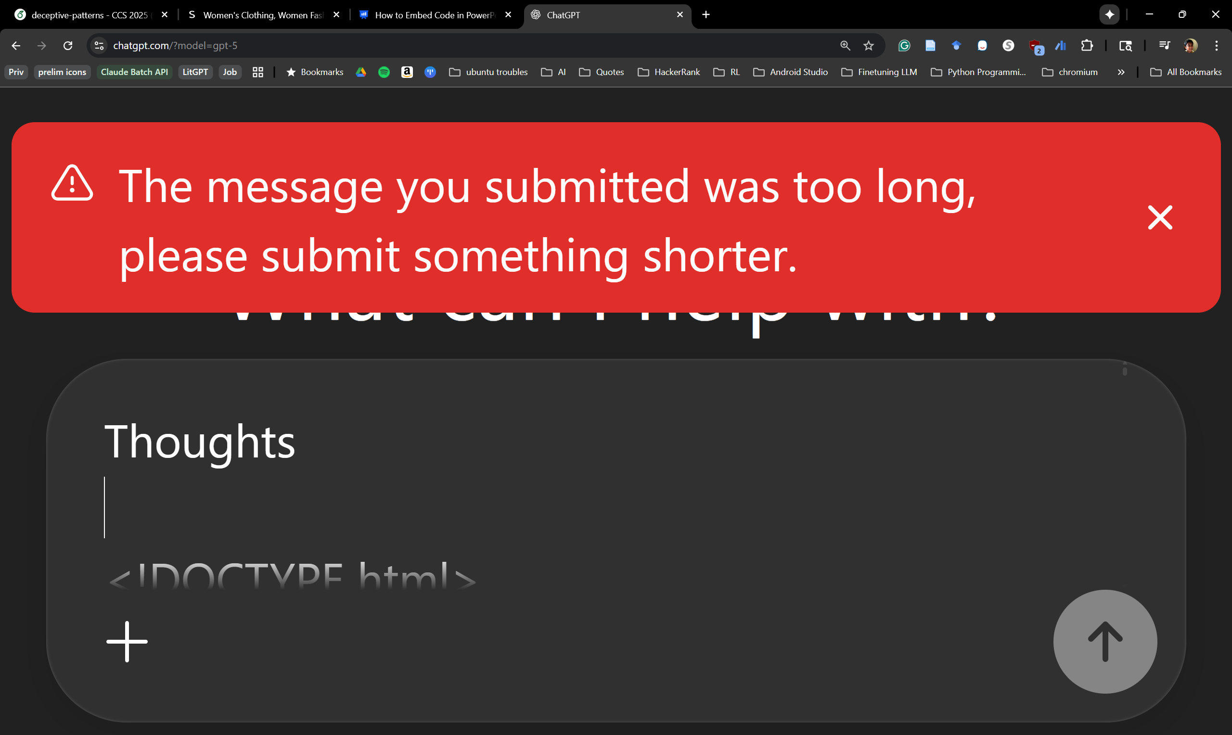

Automating DP Detection
Using Website Source Code
Heuristics
Model Input
Not generalizable
Lose Details!
Cannot Capture Dynamic UI Elements
Notes:
Help with the second point!
Front load that we use LLM to
JS is dynamic loads – not captured by source code
Talk about ads and how those cannot be captured in source code
So obviously no source code – what about screenshots?

Slide 6




Automating DP Detection
Using Vision Language Models Out-of-the-Box
Model Suffers from Hallucination
Model Input
Model Output
… Forced-Action: The website forces them to choose “Agree” or “Disagree” without providing any Customization option …
Where?
Model Output
… The website presents the “Forced Action” pattern at location: (120,100,300,177) …
Poor Web element Localization
Notes:
Due to bad localization Even if we detect it, it can’t tell us where the DP is
Swap code with VLLMs
Make ElementMap as a grounding mechanism
So to solve this we comeup with a structured representation of websites from screenshot that can be used as a grounding mechanism for the LLM to perform it’s classifications.
Motivate that LLMs are the solution but cannot just throw LLM at it. You gotta ground them!
Ofc LLM are performing well just not to the mark there are issues like these, but can we solve them? – yes through proper grounding!

Slide 7



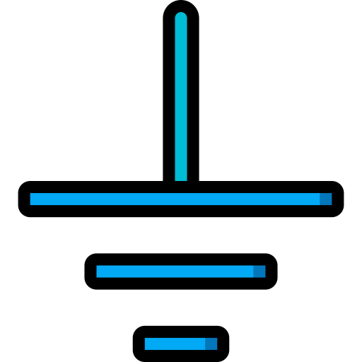
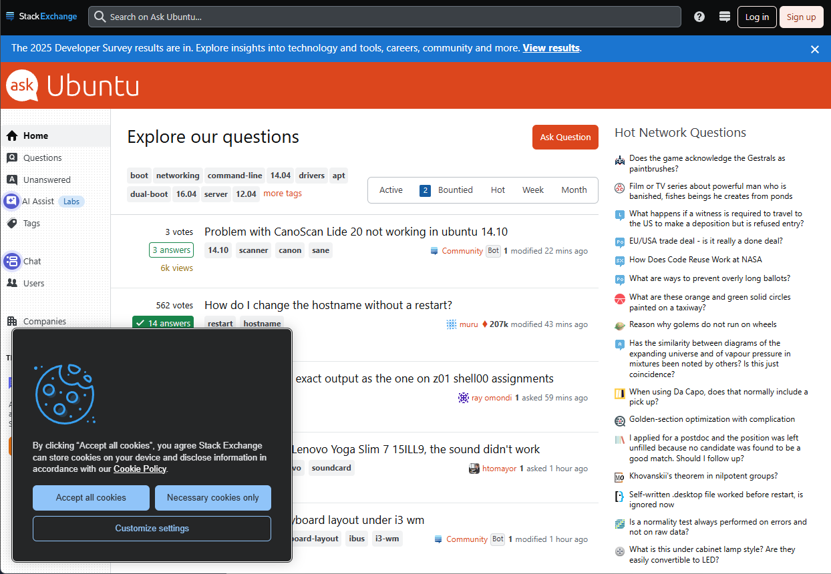
AutoBot – Automatically Detecting Online DPs
Text | Element | Top Co-ords | Bottom Co-ords | Font Size | Background Color | Font Color
Stack Exchange | text | (41, 33) | (172, 53) | 19 | Woodsmoke, (RGB: 12, 13, 14) | Curious Blue, (RGB: 55, 151, 230)
... | … | … | … | … | ... | …
Accept all cookies | button | (772, 35) | (826, 51) | 18 | Picton Blue, (RGB: 69, 177, 232) | Black, (RGB: 0, 0, 0)
Deceptive Category | Deceptive Subtype | Reasoning
non-deceptive | not-applicable | Standard element, not deceptive
… | … | …
forced-action | forced-action | No easy reject option; must accept all or customize.
Screenshot
ElementMap
Interface-Interference
Confirmshaming
Fake-Scarcity/Fake-Urgency
Nudge
Hard-to-Cancel
Obstruction
Hard-to-Cancel
Pre-Selection
Visual-Interference
Jargon
Sneaking
Hidden-Subscription
Hidden-Costs
Disguised-Ads
Trick-Wording
Forced-Action
Forced-Action
Non-Deceptive
Not-Applicable
Notes:
We implement AutoBot Using a combination of LLMs as well as vision models in a pipelined approach to address these limitations!
address the hallucination and poor localization issues we saw earlier...

Slide 8



Vision Module
Text | Top-Coordinates | Bottom-Coordinates | Font Size | Background Color | Font Color
Stack Exchange | (41, 33) | (172, 53) | 19 | Woodsmoke, (RGB: 12, 13, 14) | Curious Blue, (RGB: 55, 151, 230)
... | … | … | … | ... | …
Accept all cookies | (772, 35) | (826, 51) | 18 | Picton Blue, (RGB: 12, 13, 14) | Black, (RGB: 0, 0, 0)
Text Extractor
Text | Element | Top-Coordinates | […]
Stack Exchange | text | (41, 33) | […]
… | … | … | […]
Accept all cookies | button | (772, 35) | […]
Element | X₁ | Y₁ | X₂ | Y₂
text | 45 | 33 | 170 | 50
… | … | … | … | …
button | 780 | 33 | 850 | 70
Screenshot
UI Detector
ElementMap

Slide 9

Language Module
You are an helpful AI. You given a special CSV file with values separated by pipe (|), containing tabular data in text format from a website and a taxonomy to detect deceptive patterns. …
Verification LLM
Text | Element | […] | Deceptive Category | Deceptive Subtype | Reasoning
Stack Exchange | text | […] | non-deceptive | not-applicable | Standard element, not deceptive
… | … | […] | … | … | …
Accept all cookies | button | […] | non-deceptive | non-deceptive | Necessary only & 'Accept All' buttons available.
Text | Element | […] | Deceptive Category | Deceptive Subtype | Reasoning
Stack Exchange | text | […] | non-deceptive | not-applicable | Standard element, not deceptive
… | … | […] | … | … | …
Accept all cookies | button | […] | forced-action | forced-action | No easy reject option; must accept all or customize.
Text | Element | Top-Coordinates | […]
Stack Exchange | text | (41, 33) | […]
… | … | … | […]
Accept all cookies | button | (772, 35) | […]
ElementMap
LLM
Classifications with Reasoning
Notes:
No Gemini 1.5 → LLM(s) – one does initial class another does verification
There exists an reject option but the llm mis-reasons about … to tackle this we use a pipeline approach where we use a second llm instance to verify these classifications.

Slide 10














The LLM Spectrum
Large LM (>200B)
Small LM (1-2B)
Very Small LM (<1B)
Performance
Data Privacy
Latency
T5
Gemini 1.5 Pro
Qwen-2.5-1.5B
Notes:
Each of these have their own trade-offs
Data to an outside source

Slide 11



Creating Datasets for Evaluation
Mathur et al.¹
Tranco List
Top 1K
555 Websites
600 Websites
D3 Dataset
1. Mathur, Arunesh, Gunes Acar, Michael J. Friedman, Eli Lucherini, Jonathan Mayer, Marshini Chetty, and Arvind Narayanan. "Dark patterns at scale: Findings from a crawl of 11K shopping websites." Proceedings of the ACM on human-computer interaction 3, no. CSCW (2019): 1-32.
Notes:
We create 2 dataset – LangEval for Language Module and D3 Dataset for E2E evaluation
We use the websites from Mathur et al.¹
We randomly choose 200 websites for our LangEval dataset.
We manually correct the element classifications from the vision classifier
We choose the Top 1K websites from Tranco in addition for our D3 Dataset
We scraped DuckDuckGo with the site address and randomly picked one of the top 10 links with most number of interactable elements to avoid landing pages
Express that we create D3 with annotated websites with DP that we use to evaluate our models as well as existing works

Slide 12
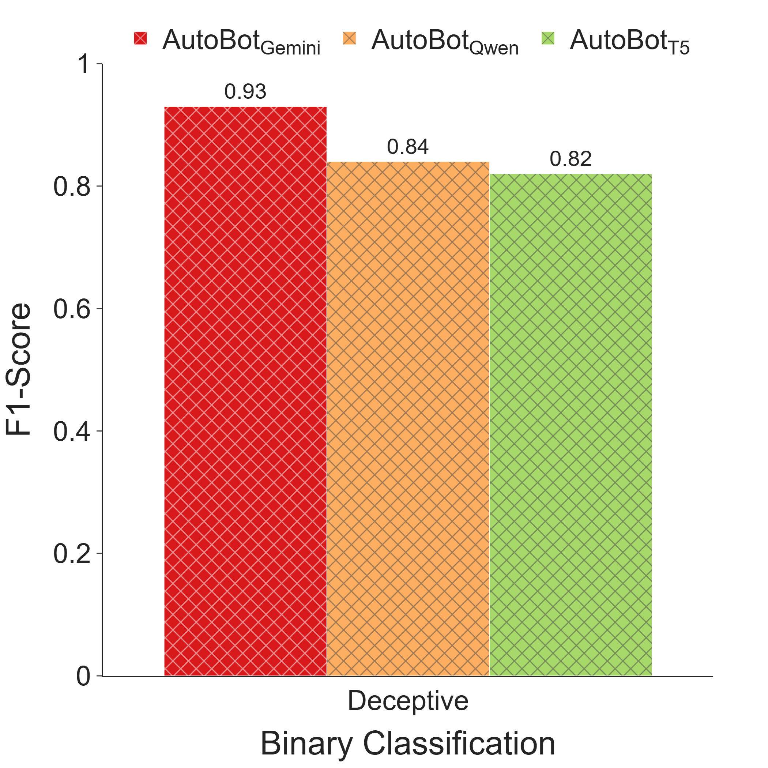
End-to-End Evaluation
Notes:
Agnostic of category and subtype classifications

Slide 13
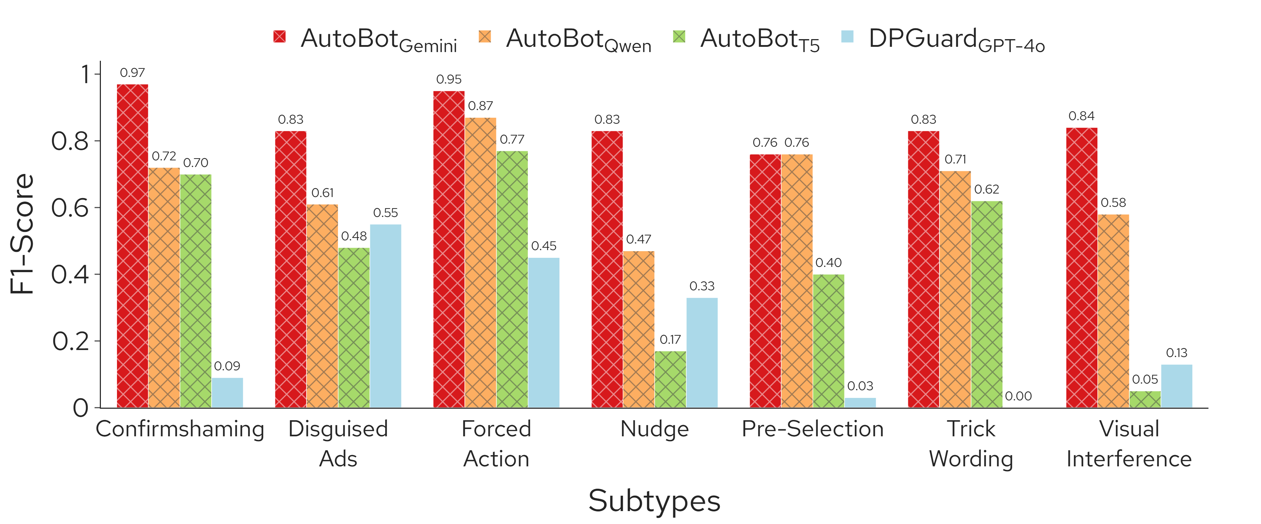
End-to-End Evaluation
Notes:
Next we perform E2E wval with the D3 dataset, and here we compare the performance of the models with an existing work (DPGuard)
We are presting subtypes where the existing works are there
Use texture to separate ours vs dpguard
AutoBot_Gemini …

Slide 14
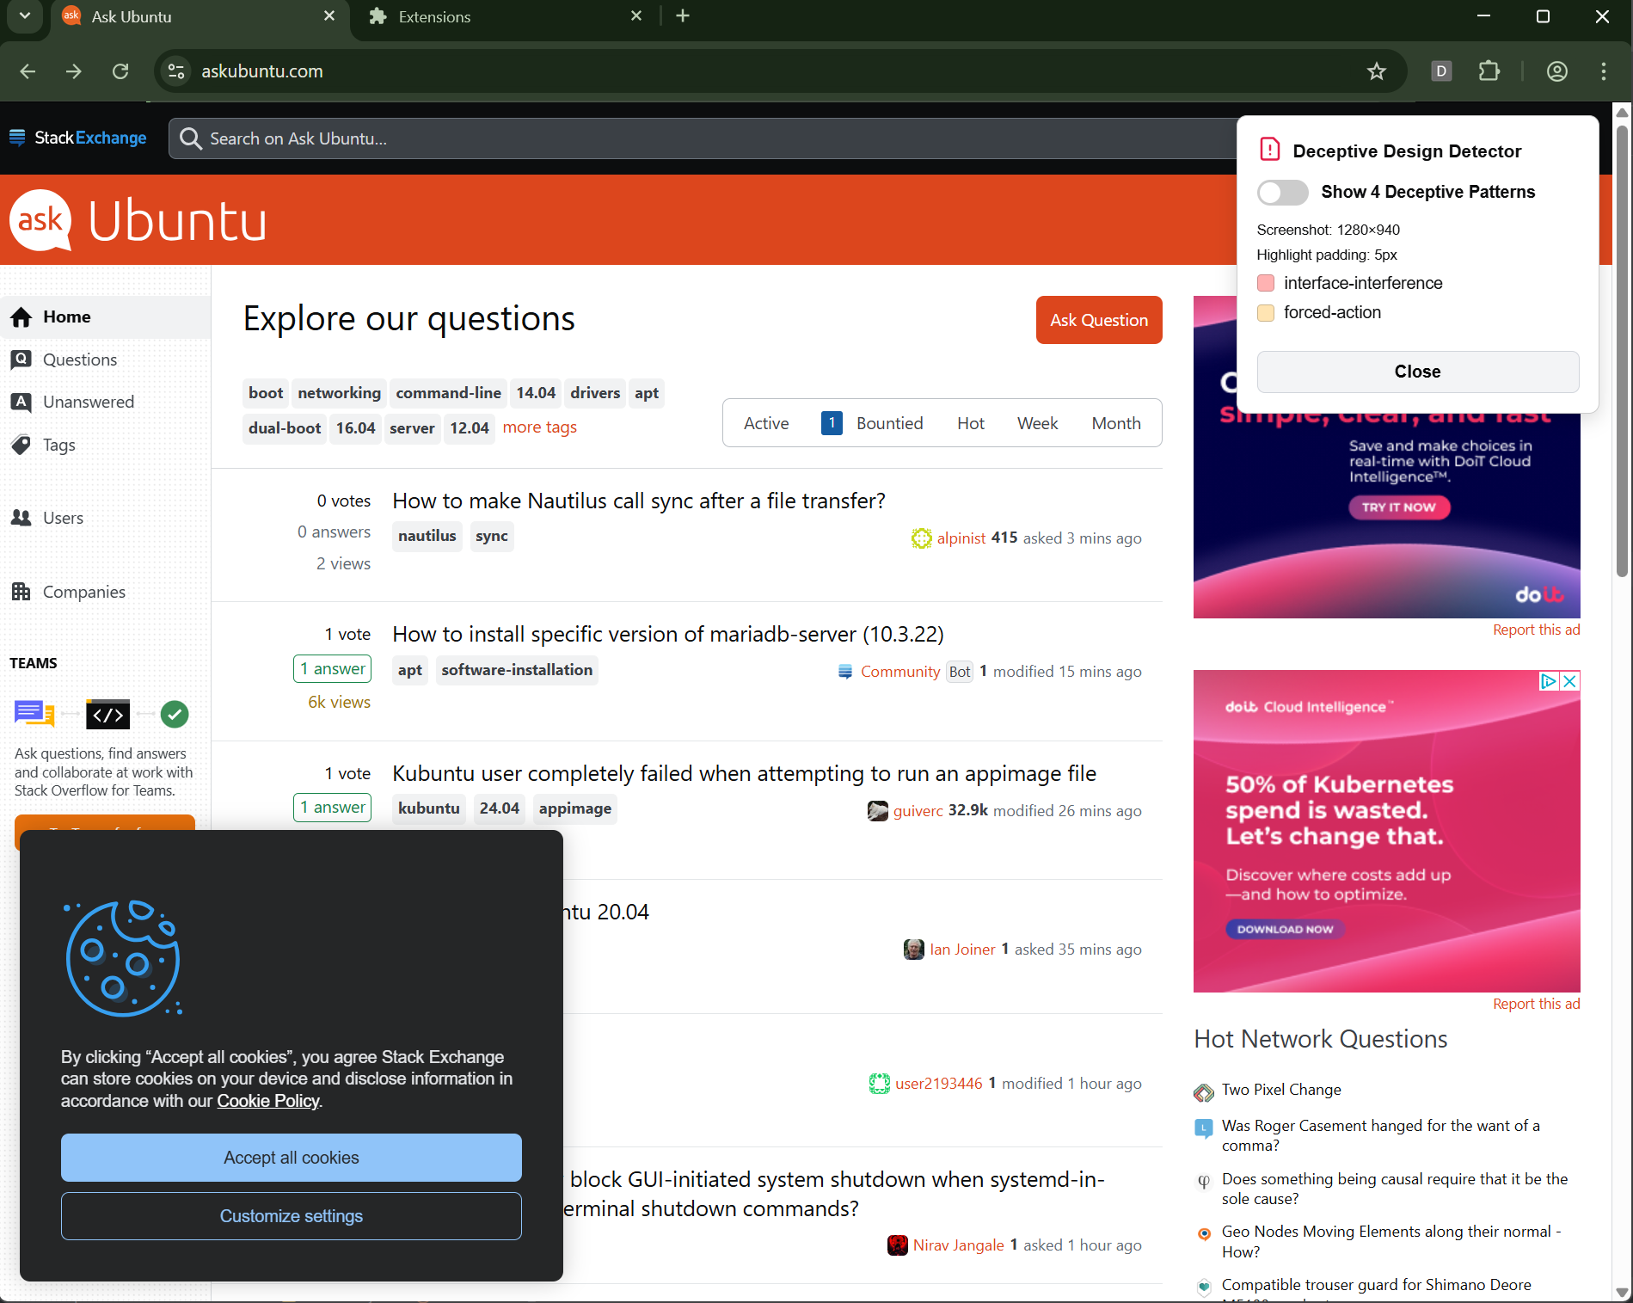
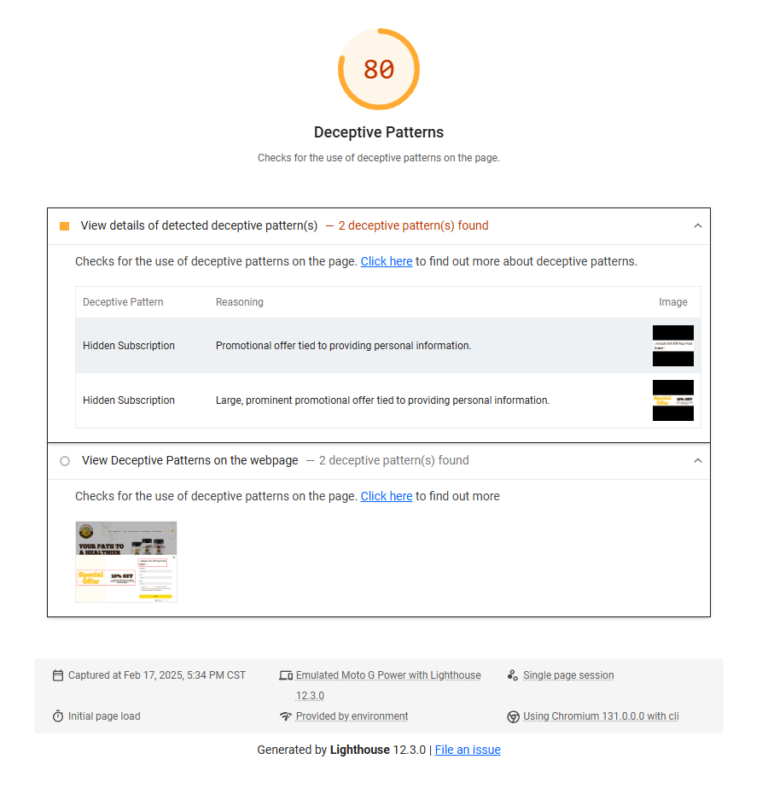
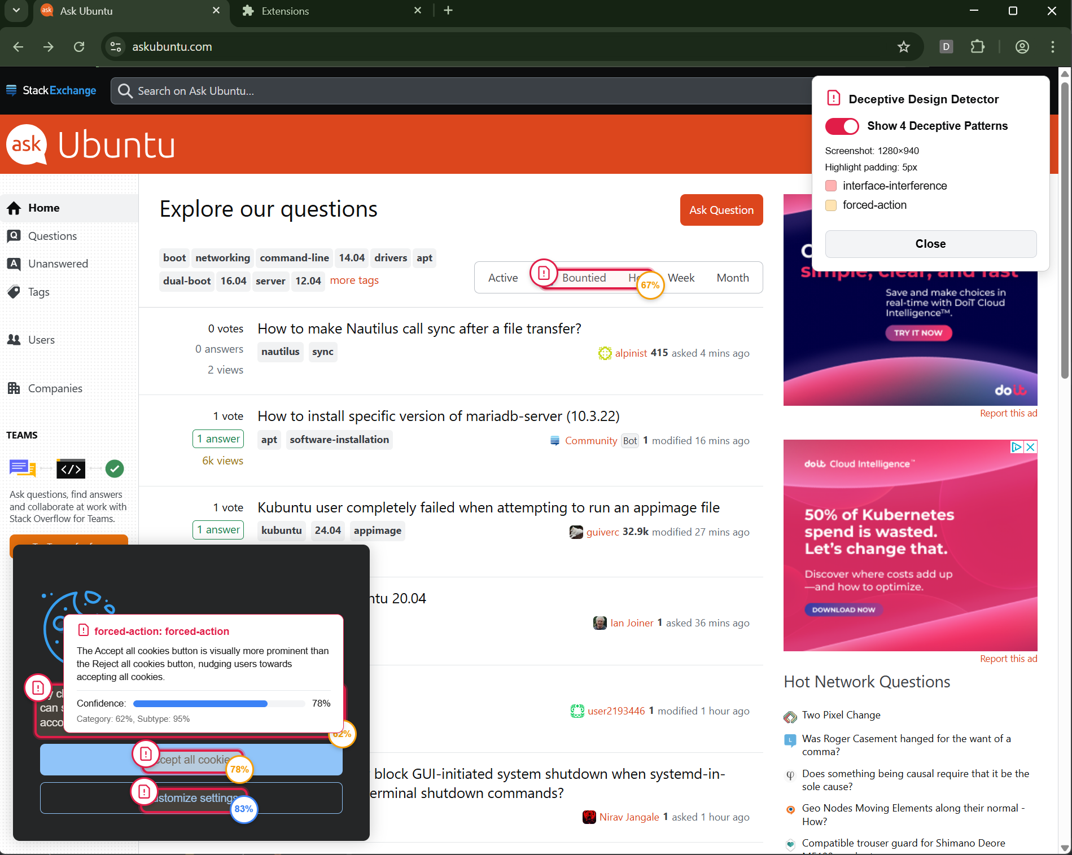
Applications
Local Browser Extension
Lighthouse Report

Slide 15
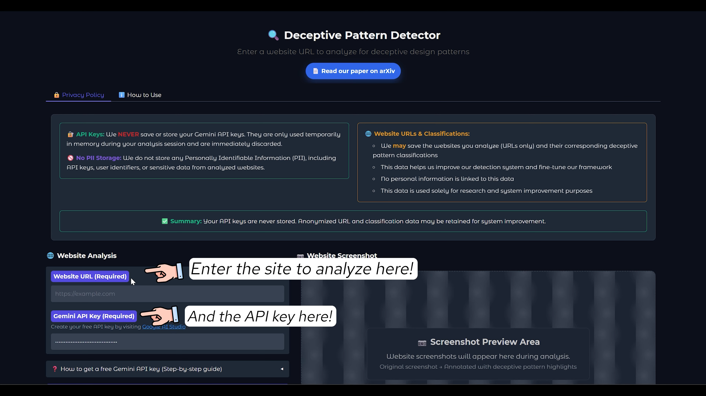
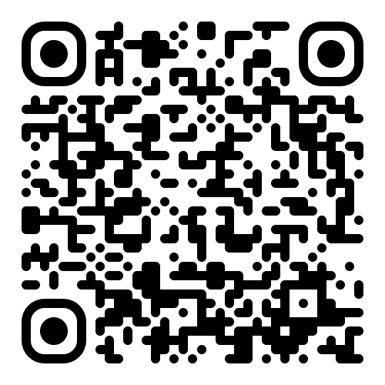
Applications
Try out the demo here!

Slide 16
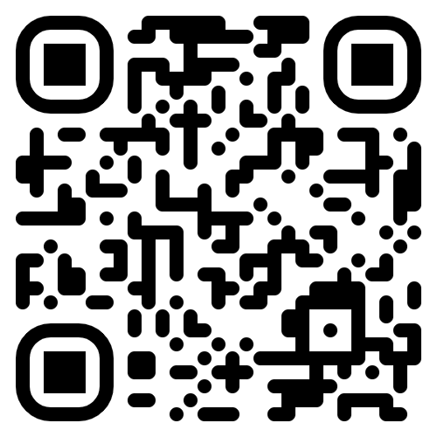
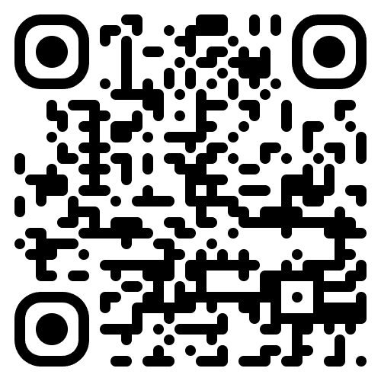
Takeaways
Automated Detection of Online Deceptive Patterns
Deceptive patterns manipulate users, and current solutions aren't effective and scalable.
We introduce: AutoBot, to detects these patterns from screenshots.
Our evaluation shows that AutoBot achieves an F1-score of 0.93 in detecting DPs
We implement AutoBot for different stakeholders of the web.
I'll be at INRIA this Spring working on Deceptive Pattern Detection. Please reach out to collaborate!
Checkout our project website
https://www.asmitnayak.com
Notes:
I will be spending the spring in Inria, so if people are interested please connect with me

